Slide 1
SMAI Project
Project : From Softmax to Sparsemax
Members : Akhilesh Soni(201530001)
Nikhil Parasaram(201501202) Raghav Gupta(201501192) Satyam Mittal(201501020)

Slide 2
Project Description
The paper focuses on sparsemax, a new activation function which is similar to softmax, but outputs sparse probabilities.
It has properties similar to the softmax and it’s Jacobian can be efficiently computed, enabling its use in a neural network trained with backpropagation.
Then, a new smooth and convex loss function which is the analogue of the logistic loss is defined for sparsemax.
Promising empirical results are obtained in multi-label classification problems and in attention-based neural networks for natural language inference but with a selective, more compact, attention focus.

Slide 3
Activation Functions
In neural networks, activation function of a node defines the output of that node given the input values
They are used in unit of neural networks which enables us to capture interesting properties of input
They are chosen to be non-linear to model the non-linear classification
The output layer has a very specific objective – to try to replicate the true labels as much as possible.
They are numerous functions like sigmoid, tanh, ReLU, softmax, sparsemax, etc

Slide 4
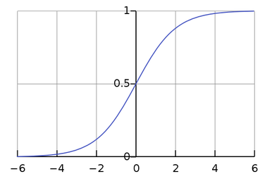
Literature Survey
Sigmoid:
Formula: σ(x) = 1 ∕ (1 + e^{-x})
Pros:
Range is between 0 and 1
Easy to understand and apply
Cons:
Vanishing gradient problem
Slow convergence

Slide 5
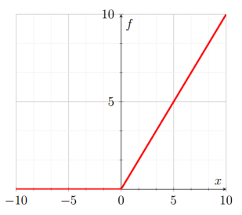
Literature Survey
b) Relu
Formula: f(x) = max(0, x)
Pros:
Accelerates the convergence of SGD compared to sigmoid and tanh
No expensive operations are required
Cons:
Vanishing gradient problem
ReLu could result in Dead Neurons

Slide 6

Literature Survey
c) Power Linear Units (PoLUs)
https://arxiv.org/pdf/1802.00212.pdf
February 2018
For positive values, It is same as ReLU.
Removes bias shift effect: Output mean close to 0
Saturation in negative part make it noise robust.
d) Swish or Sigmoid-weighted linear unit (SiLU):
f(x) = x * σ(x)

Slide 7

Softmax
Softmax Activation Function converts a vector of real weights to a probability distribution. It is useful in multi-class classification because it returns the probability vector indicating the probability of example being in the class.

Slide 8
Side effects of softmax
Finding exp(x) is computationally expensive for large values of x therefore computing the value of softmax activation is computationally expensive
Softmax never (theoretically) outputs zero probability so it does not give any sparse posterior distribution
For multi label classification softmax does not give good results
Softmax cannot be used for regression tasks

Slide 9

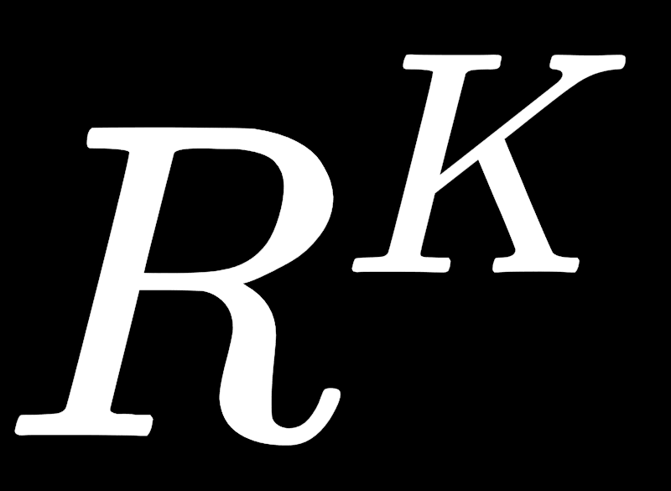
Sparsemax
Sparsemax Activation Function also converts a vector of real weights to a probability distribution but it outputs sparse distribution i.e it truncates small probabilities to zero. This is very useful in multi-class classification because it returns less number of classes indicating the main classes. It is also useful in attention based neural networks where focus is on the limited set of data instead of the whole.
Where 𝞃 : ->R is the threshold function .

Slide 10
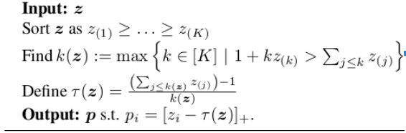
Sparsemax Algorithm

Slide 11
Properties
Sparsemax Activation Function retains the desirable properties of the softmax activation function.
ρ(0) = 1/K and lim(𝝐->0⁺)ρ(𝝐⁻¹z) = A(z)/|A(z)|. For sparsemax, the last equality holds for any 𝝐 ≤ γ(z) · |A(z)|.
ρ(z) = ρ(z + c1), for any c ∈ R
ρ(Pz) = Pρ(z) for any permutation matrix P
If zi ≤ zj , then 0 ≤ ρj (z) − ρi (z) ≤ η(zj − zi ), where η = 1/2 for softmax, and η = 1 for sparsemax.

Slide 12
Advantages of Sparsemax over Softmax
Returns sparse posterior distributions i.e assigns exactly zero probability to some of the output variables.
Jacobian of sparsemax is easy to compute and leads to faster gradient backpropagation.
Sparsemax loss is convex, everywhere differentiable
Better results on standard datasets in multi-label classification and attention based neural networks in comparison to softmax.

Slide 13

2-D Case
Consider the input vector as z = (t, 0)
Then the softmax1(z) reduces to nothing but the sigmoid i.e softmax(z) = σ(t) = 1 ∕ (1 + e^{-t})
In the sparsemax case the output is

Slide 14
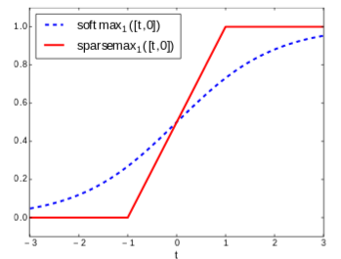
Sparsemax vs Softmax
Comparison of Softmax vs Sparsemax for 2-D Case.

Slide 15

Jacobian Softmax
The Jacobian matrix of a transformation ρ, is of key importance to train models with gradient-based optimization
Jacobian of softmax is

Slide 16

Jacobian Sparsemax
The Jacobian matrix of a transformation ρ, is of key importance to train models with gradient-based optimization
Jacobian of sparsemax is :

Slide 17
Convergence
Jacobian of sparsemax is same as the Laplacian of a graph whose elements of S(z) are fully connected. To compute it, we only need S(z), which can be obtained in O(K) time with the same algorithm that evaluates the sparsemax
Jacobian of softmax takes O(n) time to compute where n is the number of labels
Therefore sparsemax leads to faster gradient backpropagation than the softmax, particularly in the case when number of important classes << number of classes

Slide 18


Sparsemax Loss Function
Sparsemax loss is defined as a sparse analogue of logistic loss function. The definition is
The loss function is convex and always greater than or equal to zero
The loss function is differentiable everywhere and its derivative is given by

Slide 19

MultiLabel Classification
Till now we have discussed about multiclass classification, which has only 1 target label, whereas in multilabel classification there can be multiple labels as target.
We can consider more general problem of sparse label proportion estimation. The loss here is defined as KL divergence between target labels and activation of the output of network.
Where KL divergence is

Slide 20


MultiLabel Classification
After expanding it we get a generalization of multiclass classification.
After taking the gradient for the loss the H(q) term(shannon entropy) will be eliminated which leads to the above equation which is generalized form of the equation for multiclass classification.

Slide 21

MultiLabel Classification
We will generalize the same result for sparsemax as the following.
After taking the gradient we will end up with the generalized expression of multiclass loss gradient , which is quite interesting.

Slide 22
Experiments
Dataset | Softmax | Sparsemax | Logistic
Scene(6 labels) | 72.8% | 72.6% | 68.4%
Emotions (6 labels) | 64.3% | 64.1% | 64.5%
Birds (19 labels) | 44.1% | 44.3% | 41.7%
CAL500(174 labels) | 41.3% | 42.5% | 43.1%
Reuters(100 labels) | 75.6% | 76.2% | 75.1%

Slide 23
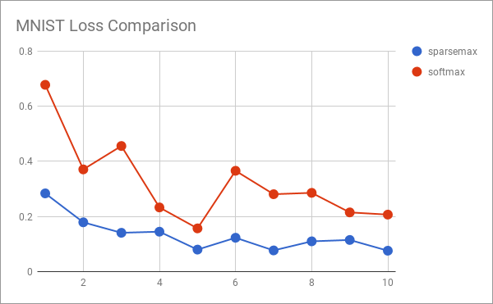
MNIST Dataset (loss vs epochs)

Slide 24
Attention based Learning
These techniques are mainly used in text related domains(can also be used for images).
In this method the model trains itself to find important words in the sentences, rather than considering the entire sentence.
With this it will be helpful in lot of tasks like neural machine translation, NL inference problem, generating image descriptions (link) .
Sparsemax will be better than softmax as an activation in this case because of its ability to generate sparse probabilities only some words(or parts in an image) are selected which would be the key for making the final decision.

Slide 25
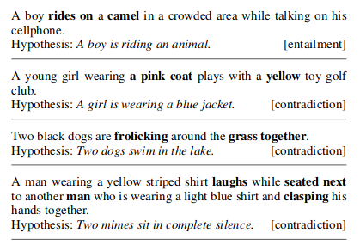
NL inference problem
We will be given a premise and a hypothesis.
Using these we need to say whether the statements entail or contradict each other or are neutral.
The above highlighted words are the ones to which sparsemax gave attention to.

Slide 26
NL inference experiment
Model | Validation | Test
No Attention | 80.42% | 78.3%
Logistic Attention | 80.28% | 78.56%
Softmax Attention | 81.4% | 80.9%
Sparsemax Attention | 81.27% | 81.02%

Slide 27
Conclusion
Introduced sparsemax transformation having similar properties as softmax but able to output sparse probabilities
Derived its jacobian needed for the backpropagation algorithm
Defined a sparsemax loss function which is convex and differentiable
Empirical results shown in multi-label classification, and NL inference.

Slide 28
References
Research paper: From softmax to sparsemax https://arxiv.org/pdf/1602.02068.pdf
Statistical Learning with Sparsity : the Lasso and Generalisations.
Optimisation and NonSmooth Analysis by Clark Frank.
Pattern Classification by Richard O. Duda.
Pattern Recognition and machine learning by Christopher Bishop

Slide 29
Thank You !

